Slide 1
Berserker
Presented by 8-bit bacon

Slide 2
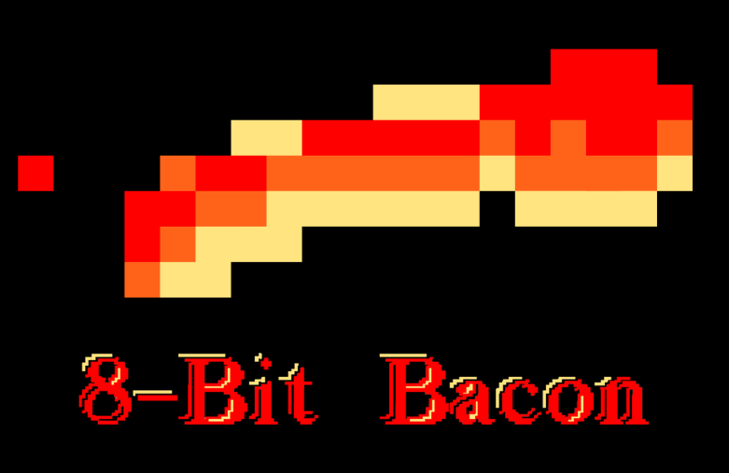









Team
Anton
Lopez
Charles “CJ” Meade
Daniel
Lima
Justin
Maza
Matthew Birky
Roberto Rubiano
Sean
Welch
Oscar
Araque
Santiago Hoyos

Slide 3
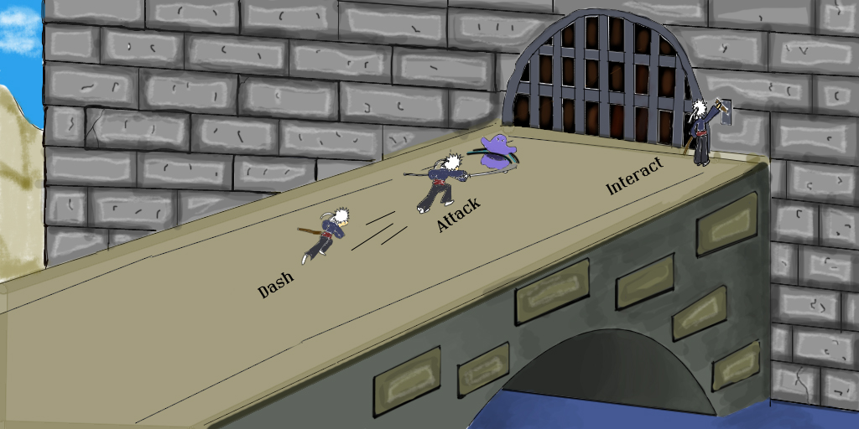
Game Vision

Slide 4
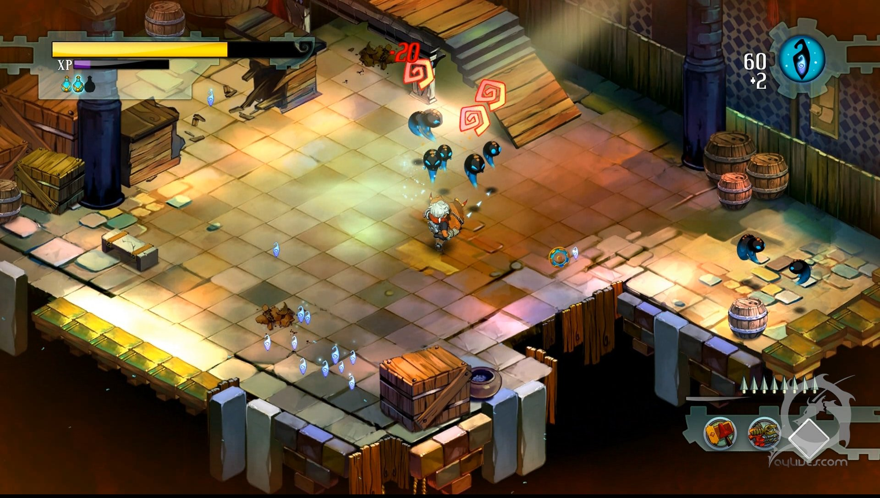

Inspiration

Slide 5
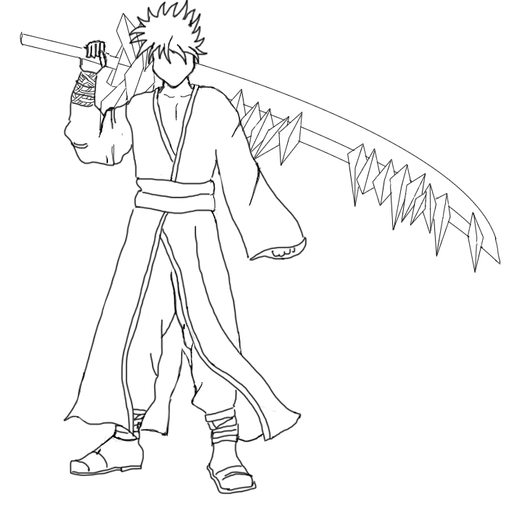
Hero
Seasoned, tall, lean warrior who wields a one-handed sword
Lover was kidnapped
Needs to master the powers of Ice and Fire to fight the Wizard

Slide 6


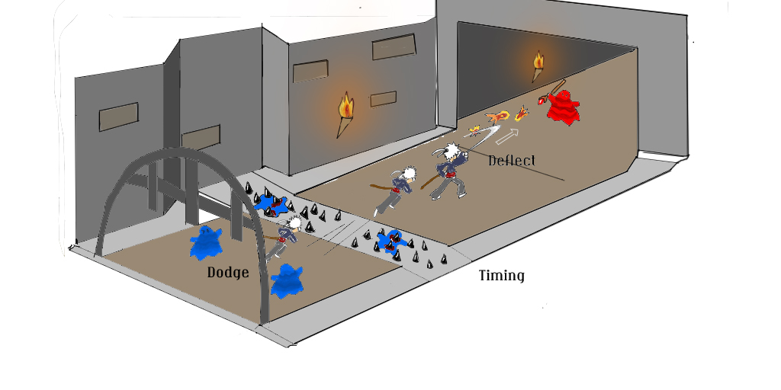
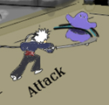
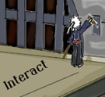
Actions
X Button
Left Click
Attack (65%)
Damage enemies
Manipulate the environment
Deflect projectiles

Slide 7
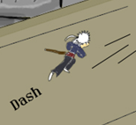
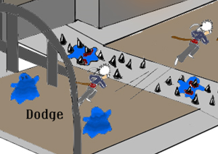
Actions
A Button
Space Bar
Dash (25%)
Close distance
Avoid enemies and traps
Knock enemies back
Destroy frozen enemies

Slide 8
Actions
B Button
“F” key
Rage (10%)
Increments when attacking, decrements otherwise
Player attacks faster and stronger
When fully loaded, release a special attack that consumes it
Notes:
As the player attacks enemies, his Rage bar will increase. As it increases, the player will attack faster and do more damage. Once his rage bar is filled, the player can press a button to release a special attack that will be different depending on the ability he has currently selected. With the Basic Rage he’ll rotate with his sword, dealing damage around him. With the Ice Rage he’ll freeze certain enemies that are in front of him. With the Fire Rage he’ll throw a huge fireball in the direction he’s facing, which will bounce between a couple enemies dealing damage.
If the player spends some time out of combat the rage meter will start decreasing.

Slide 9
Level Flow
Level Start
Close distance
Attack enemies
Deflect ranged attacks
Attack enemies
Dodge spikes
Pull lever to open door
Attack enemies
Avoid Yeti’s ground punch
Finish the Yeti
Level End
Deflect ranged attacks
Attack
Dash
Rage

Slide 11
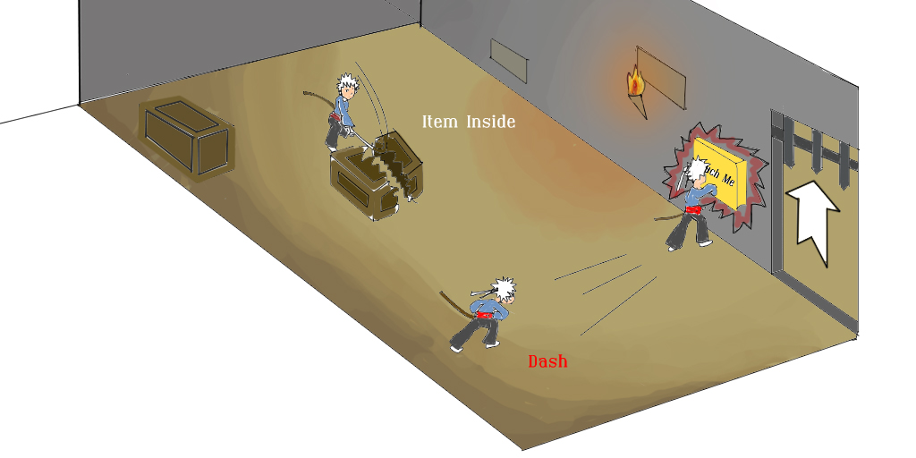

Slide 12
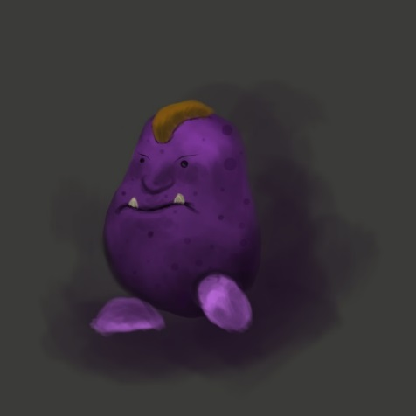
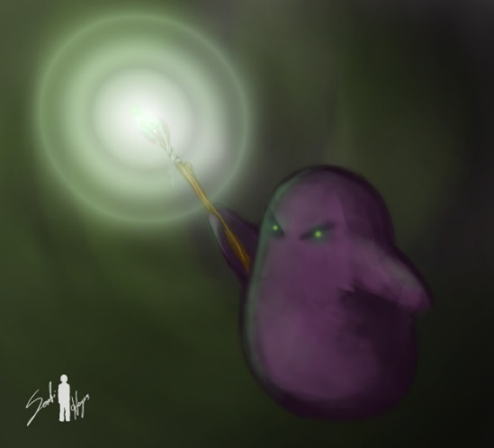
Enemies
Melee Minion
Attacks player with a melee attack
Small damage
Ranged Minion
Attacks player by throwing an orb
Decreases rage
Medium damage
Notes:
Melee minions will come in large groups and the player will have to deal with them by using his regular attacks, dashing into them (which would knock them away), attracting them to traps or using his rage attack to kill a bunch of them at once.
Ranged minions will come in small groups that will usually stay behind the melee minions. They will throw orbs on the player. If the player is hit by them, he will be suffer some low-medium damage and will loose some of his rage, making his attacks slower and affecting his momentum. The player can use his sword to deflect the orb back at the minion though.

Slide 13
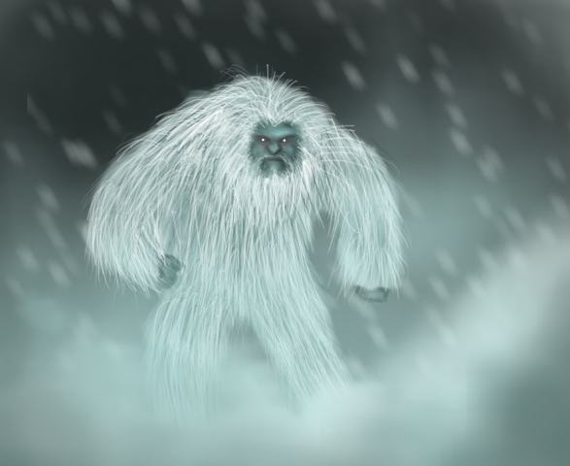
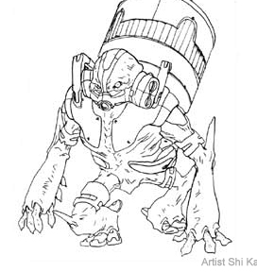
Enemies
Yeti
Attacks the player with a slow, but strong punch
Hits the ground making ice spikes erupt around him
Explosive Minion
Lights his bomb when gets close to the player
Explodes after 2 seconds
Notes:
Yetis are tank monsters who live on the ice realm. They move towards the player and once they get in range for their melee attack they charge a really strong punch that deals a lot of damage. The player will have to watch out for those attacks and time his dashes correctly. Besides that, the Yeti will eventually punch the ground, making ice spikes erupt all around him. However, this will let the Yeti dizzy for a couple seconds, so if the player manages to dash the spikes he may use his Basic Rage attack to destroy the ice and deal significantly more damage to the Yeti.
Explosive minions will have a bomb on their back. They will move towards you and when they get close they will light their bomb, which will explode after 2 seconds, dealing area of damage to all units around him (including other enemies). The player can attack and safely kill the minion before the bomb is activated. After the bomb is lit, though, attacking it will only make it blow up sooner. During all times, the player can dash into the explosive minion to knock him back.

Slide 14
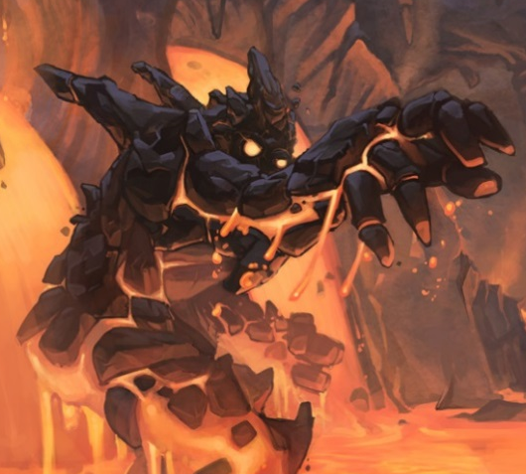
Enemies
Magma Beast
Transforms into a sphere and quickly rolls towards the player
Can be frozen and broken into pieces afterwards
Twin Minions
Melee and Ranged
Revive each other
Need to kill the two at once
Notes:
Magma beasts are tank monsters who live on the fire realm. When they get within a certain range from the player, they will transform into a rock sphere and quickly roll towards the player, who will be required to time his dash well to escape such thread. If a Magma beast hits him, the player will be knocked back and loose part of his rage. It will take some time to defeat this monsters with just regular attacks, but a certain technique can make it way faster: The player can use his Ice Rage attack to freeze the enemy and then dash into him to break him into pieces.
The Twin minions will always come in pairs. They can throw orbs at you just like the ranged minions do but they can always use melee attacks if you get to close. What is unique about them, though, is that every time you kill one of them, the other is going to revive him. So the only way to actually get past this pair of enemies is by using your Fire Rage ability to throw a fire ball which will bounce between the two and kill both of them before they can do anything about it.

Slide 15
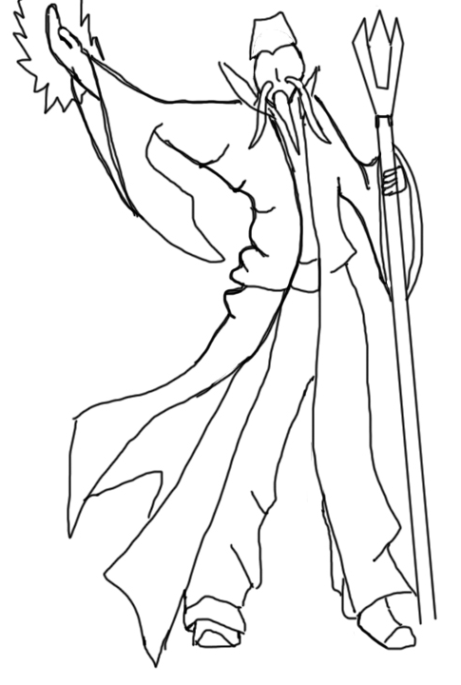
Final Boss (Wizard)
First State
Boss shield
Throw orbs
Spawning minions
Deflect 3 orbs to stun
Notes:
The final boss will be in the center of the castle. If the player tries to approach him to attack initially he will just get knocked back and loose some health because the Wizard has a protective shield. Melee minions, Ranged minions and Yetis will be spawned every once in a while. The boss will eventually raise his staff and throw a magic orb at the player. This orb can be deflected using a timed attack that the player should know by now since he fought a lot of ranged minions before. After deflecting 3 orbs, the boss will be stunned, his shield will go off and the player will be able to attack him for a couple seconds.
When the boss gets to 66% health, he realizes throwing orbs that the hero can deflect might not be a great idea, so he will start making lava eruptions below the character’s feet, requiring him to dash quickly so he doesn’t get burned. Explosive minions will also be spawning now. In order to break the Wizard’s shield again, the player will have to use the explosives in his favor, dashing at them and throwing them at the boss. After doing that 3 times, the boss will be stunned again, his shield will go off and the player will be able to attack him.

Slide 16
Final Boss (Wizard)
Second State (66%)
Boss shield
Erupt lava
Spawning explosive minions
Throw 3 bombs to stun

Slide 17
Final Boss (Wizard)
Final State (33%)
Orbs of Lava
Use Ice Rage
Illusions
Use Fire Rage
Notes:
At 33% health, the Wizard can’t manage to keep his shield up anymore, so he’ll basically go after the player using two different spells which he’ll alternate between.
The first spell creates orbs of lava rotating around him that will deal big bursts of damage if touches the player. Our hero will have to charge his rage as he runs away and cool off that Wizard with the Ice Rage before dashing into him and being able to do a couple more hits.
The second spell will split the Wizard into two different images that will both throw orbs at the player. Whenever the hero tries to hit one of them it won’t be effective because both images are illusions. By using the Fire Rage the player will be able to throw a fire ball at any of the images, which will bounce and reveal the real Wizard invisible behind them.

Slide 18
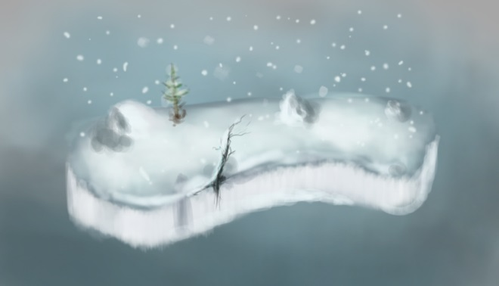
Where
The Ice Realm
Notes:
The hero starts his journey going through the Ice Realm. This is where the player will learn the basic mechanics of the game by fighting against melee and ranged minions at first and Yetis afterwards. By the end of the level, the player will acquire the Ice ability and will now have his second Rage Attack, which freezes certain enemies in a cone in front of him.

Slide 19
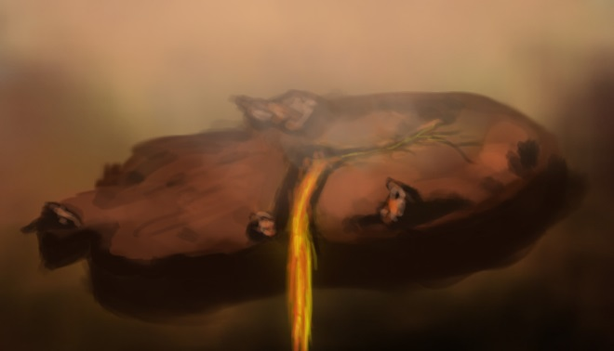
Where
The Lava Realm
Notes:
After learning the game mechanics and acquiring the Ice ability, the player will have to put his skills to practice into a more challenging level. In the Lava Realm, Magma Beasts and Explosive Minions will be introduced, and the player will need to know how to use his dashes and rage attacks at the right times to deal with those guys. Halfway through the level, the player will acquire the Fire ability, which lets him throw a fire ball that will bounce between enemies dealing damage to all of them. The Twin minions will start appearing after that.

Slide 20
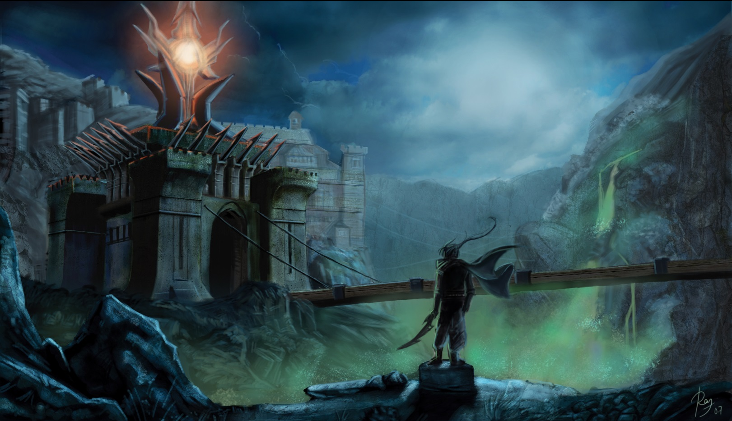
Where
The Wizard’s Castle
Notes:
Now that you’ve mastered the Ice and Fire powers you’re ready to go to that Wizard’s castle a kick his ass!

Slide 21
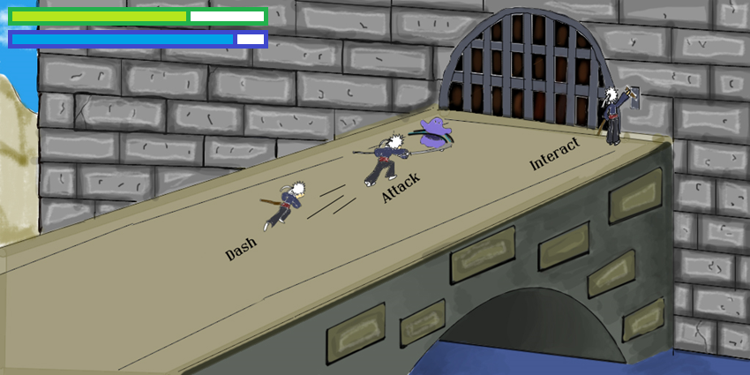
HUD

Slide 22
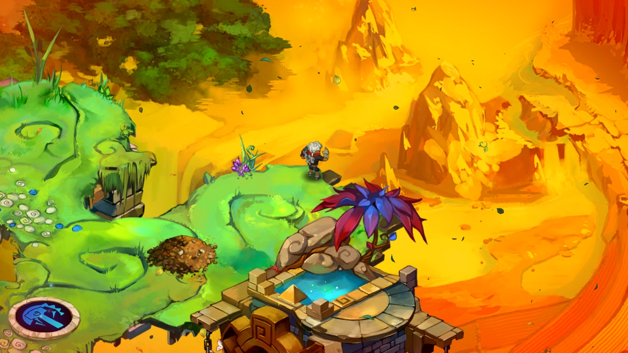
Art Style

Slide 23
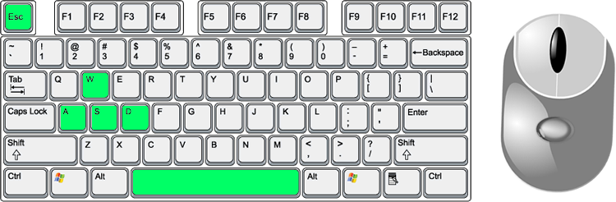
Controls
Pause
Rage
Attack
Rage Type
Move
Dash

Slide 24

Controls
Rage Type
Attack
Move
Rage
Pause
Dash

Slide 25
Recap
Intense, fast-paced ¾ view Hack-and-Slash
The mechanics are based on attacking, dashing and building up your rage
Takes place in an alternate fantasy realm
You control a seasoned warrior who is on a quest to save his lost love

Slide 26
Questions?

